Slide 1
Introduction to Bioinformatics
In the name of the most high
Translation
Ali Sharifi-Zarchi
Department of Computer Engineering, Sharif University of Technology
The contents including images and videos are from Bruce Alberts et al. Essential Cell Biology,
unless indicated separately.
These slides are available under the Creative Commons Attribution License.

Slide 2
Translation:
Making Proteins from RNA

Slide 3
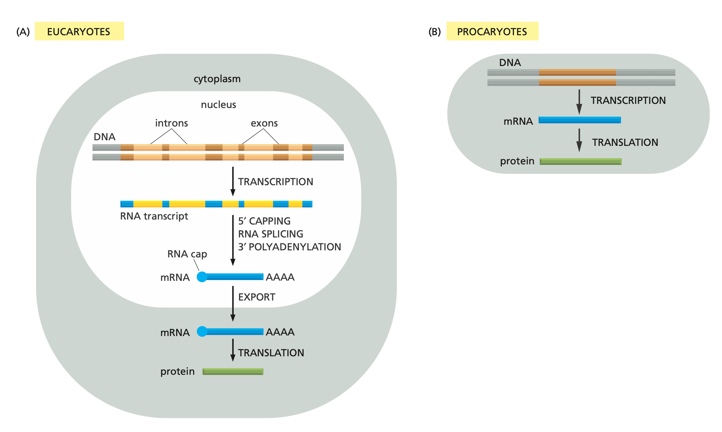
Eukaryotic & Prokaryotic

Slide 4
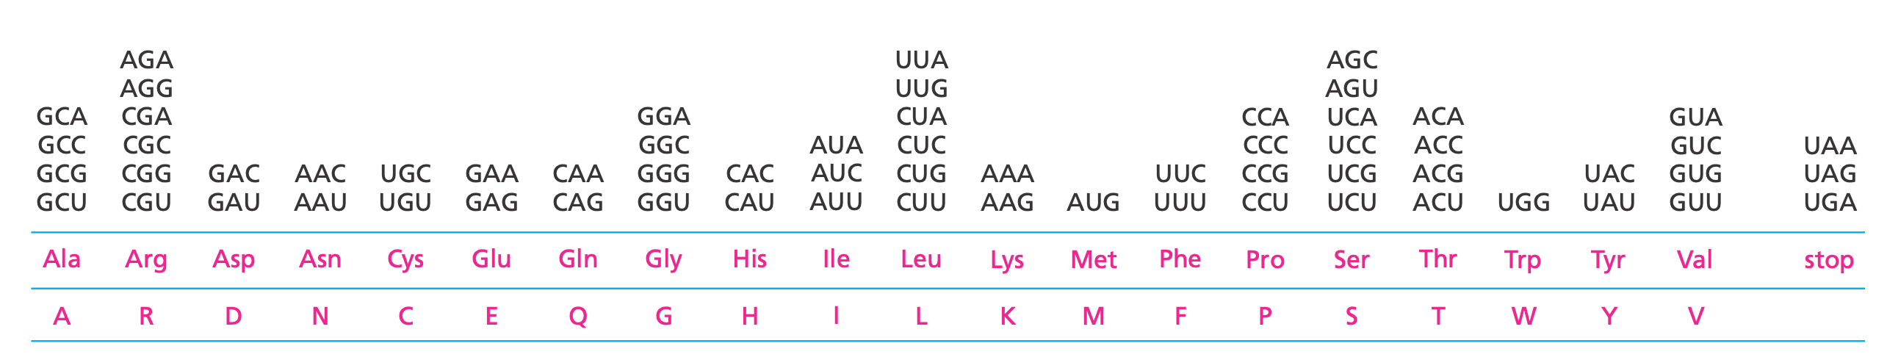
64 -> 20 Code Table
Notes:
One codon—AUG—acts both as an initiation codon, signaling the start of a protein-coding message, and as the codon that specifies methionine

Slide 5
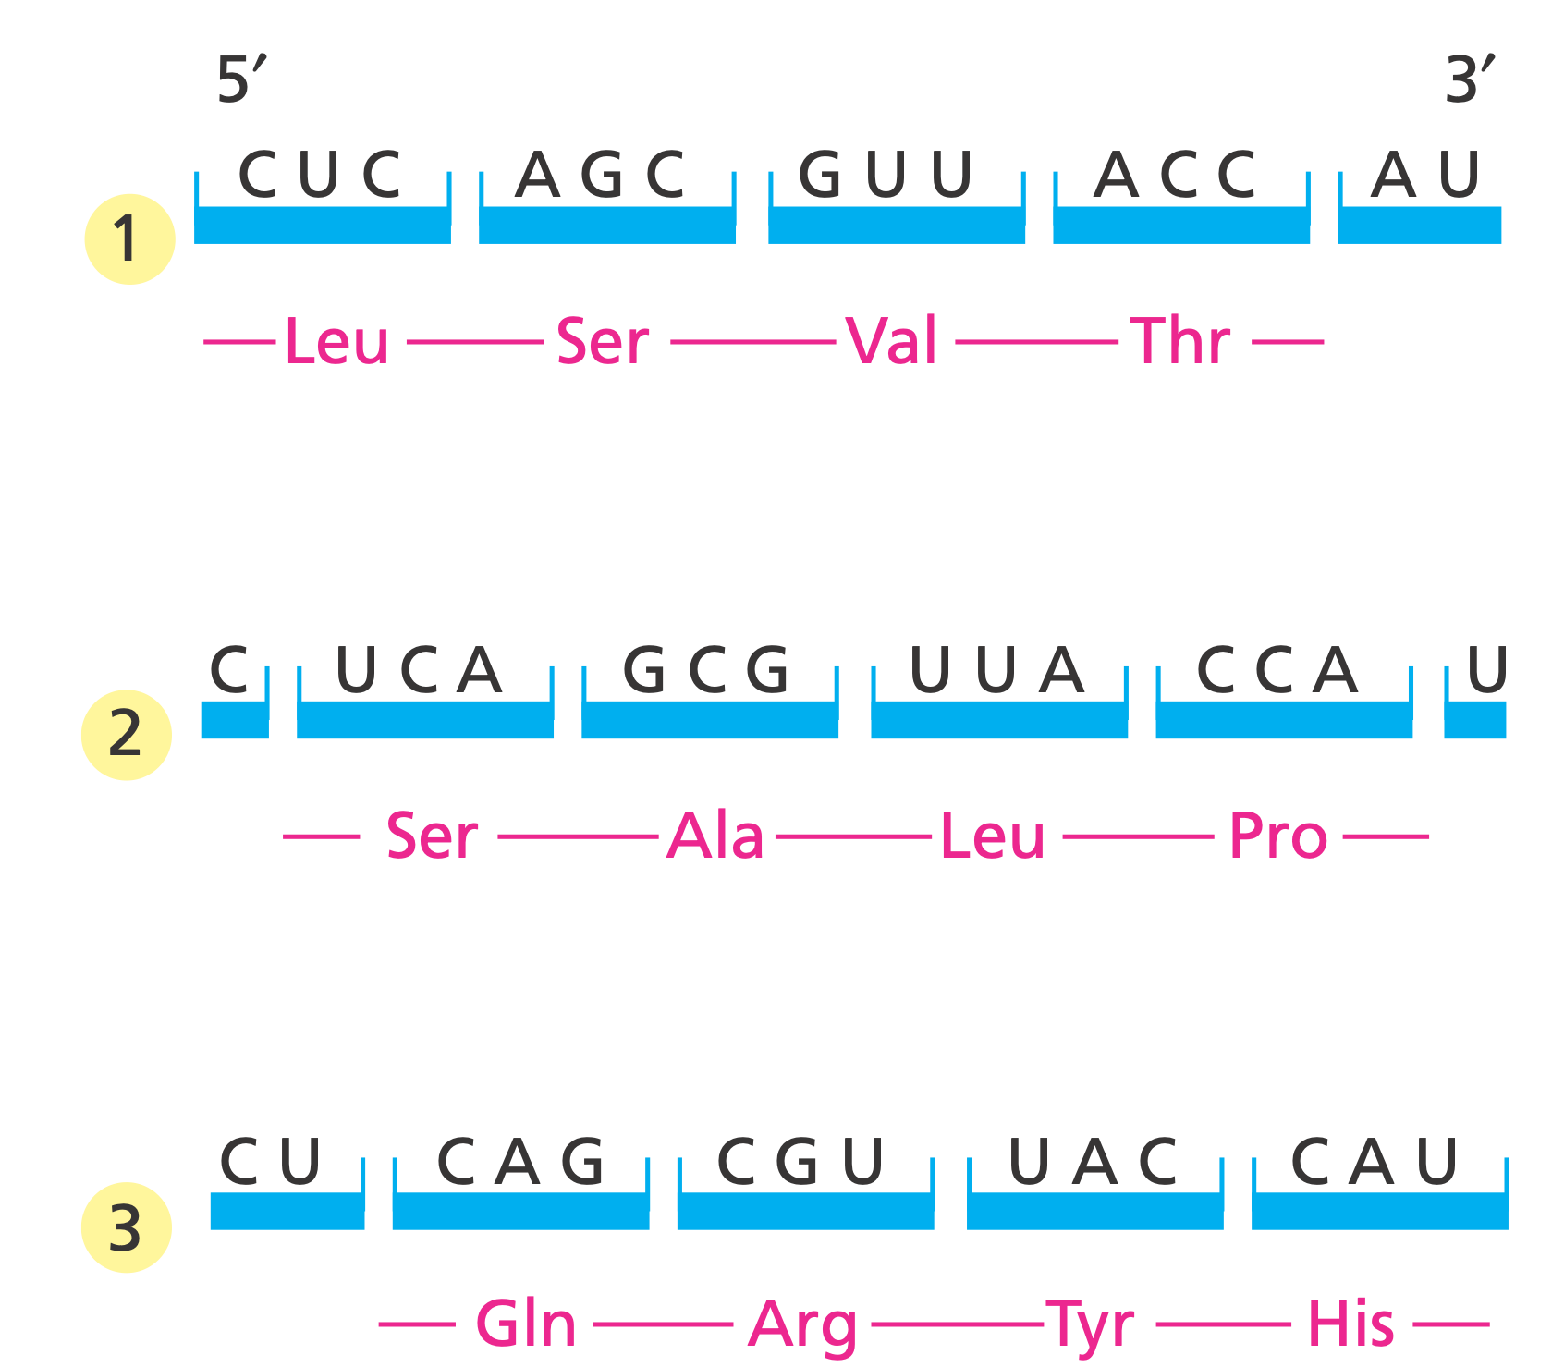
3 Possible Reading Frames

Slide 6
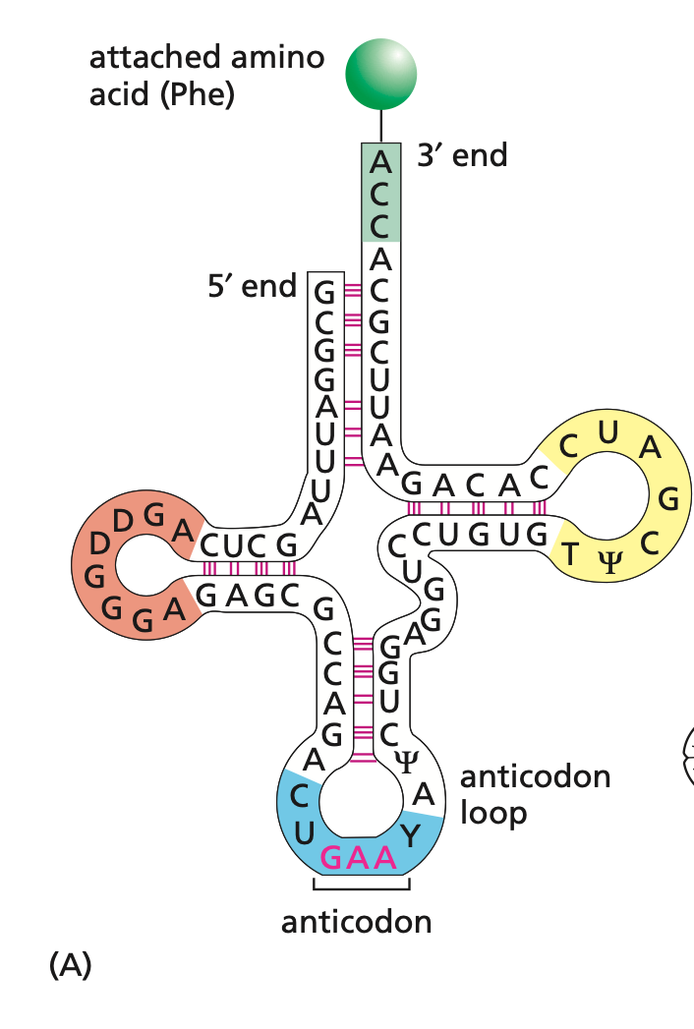
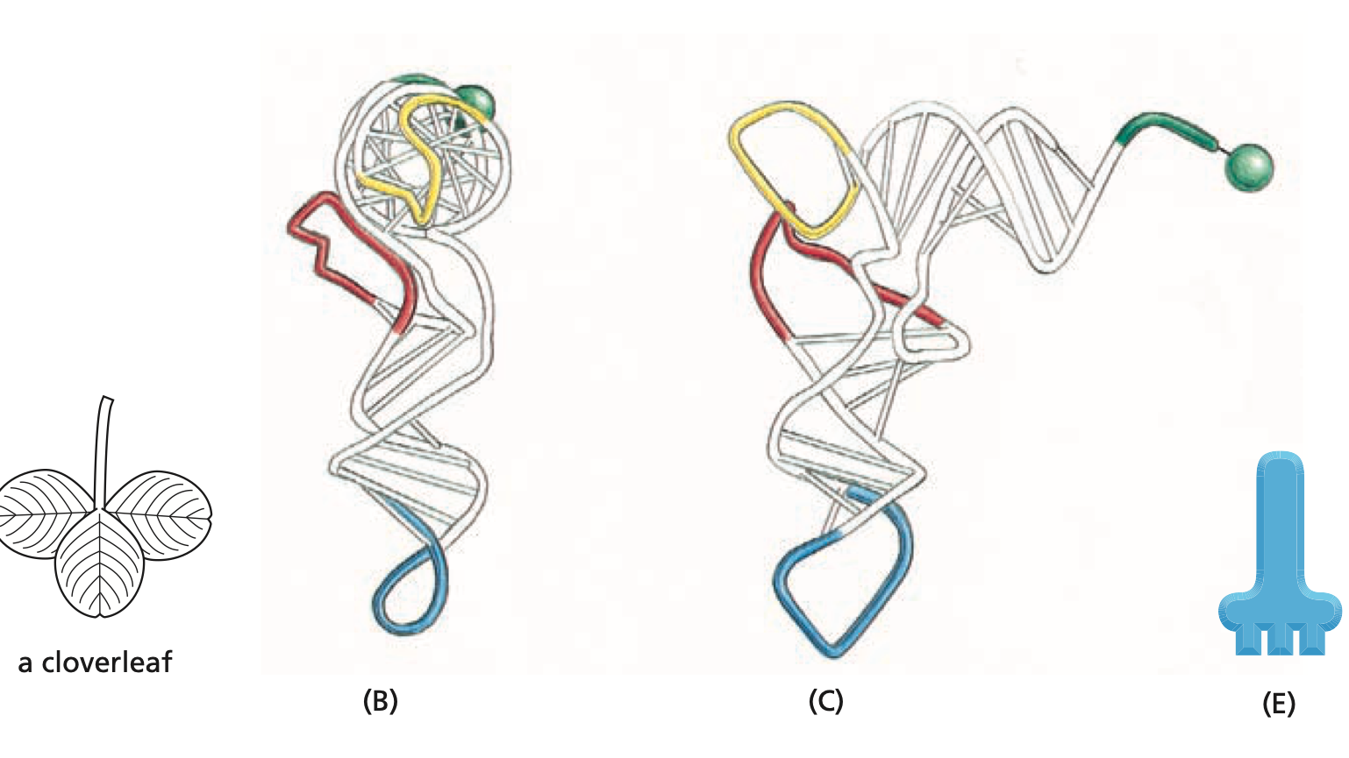
transport-RNA (tRNA)

Slide 7
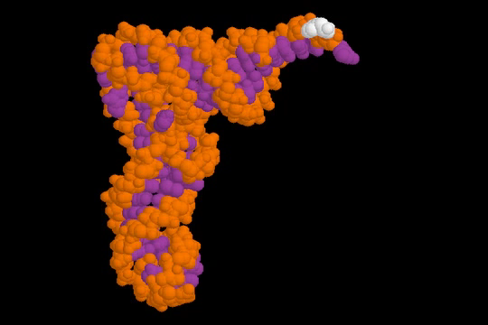
tRNA

Slide 8
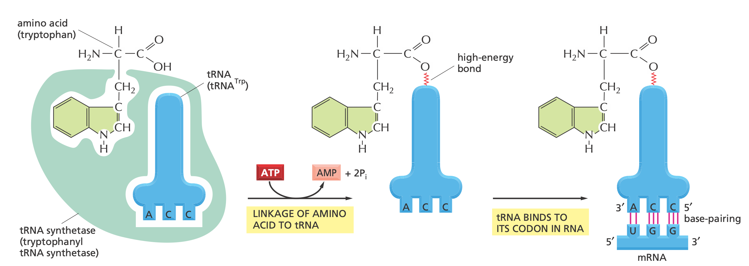
Specific Enzymes for tRNA Synthesis

Slide 9
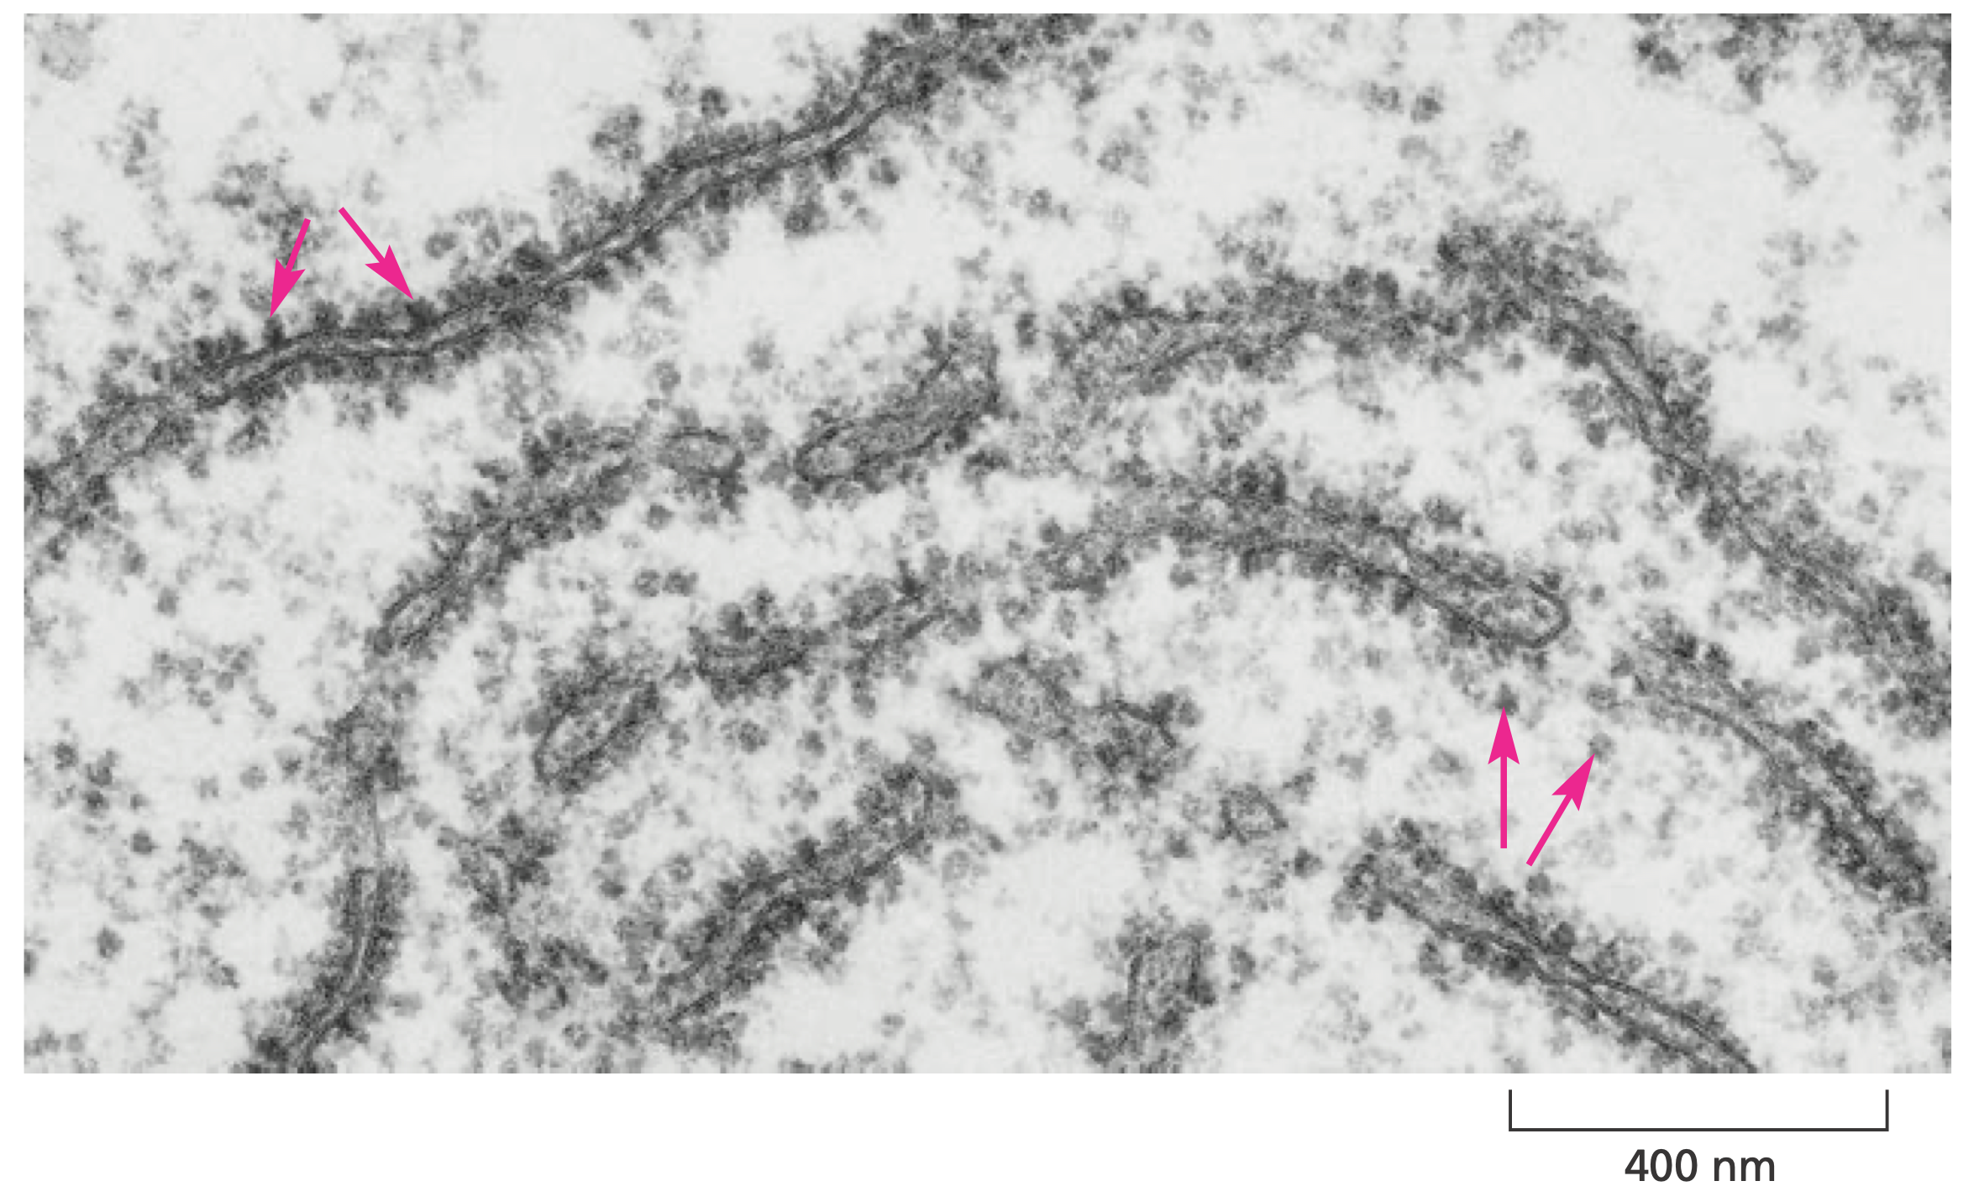
Ribosomes

Slide 10
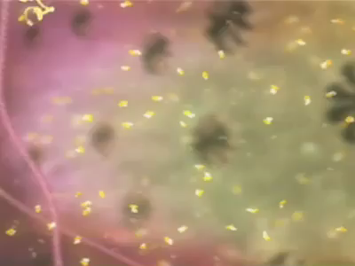
Translation

Slide 11
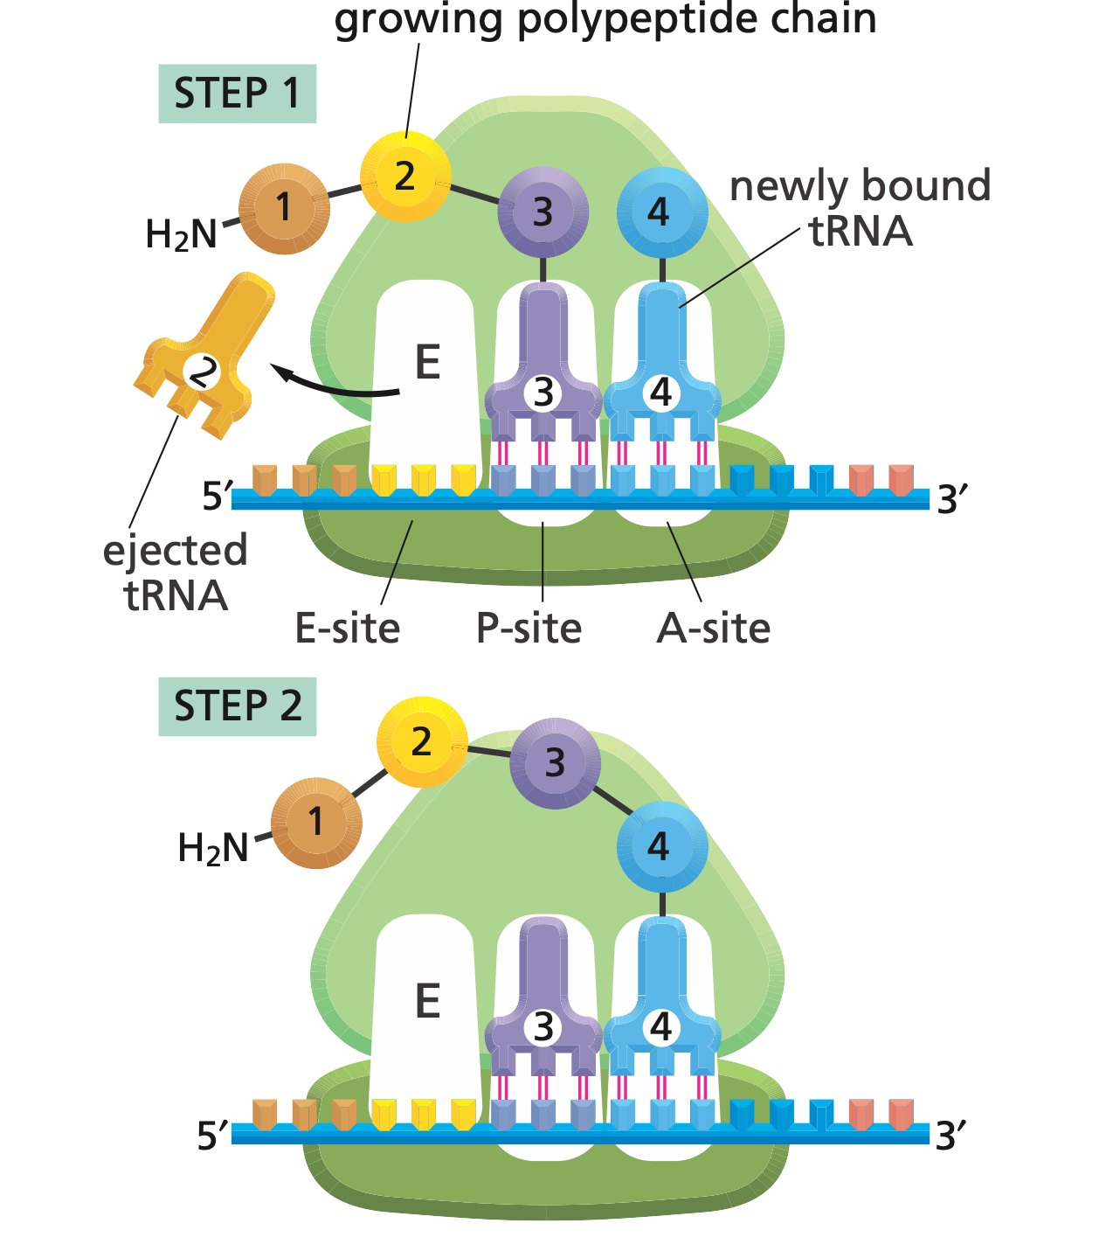
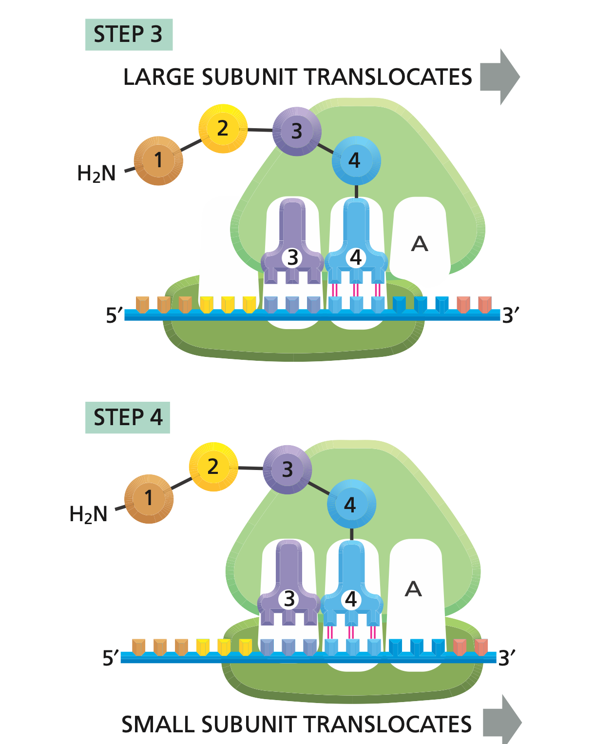
4-Steps

Slide 12
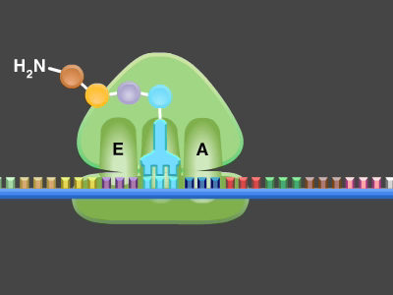
4-Steps

Slide 13
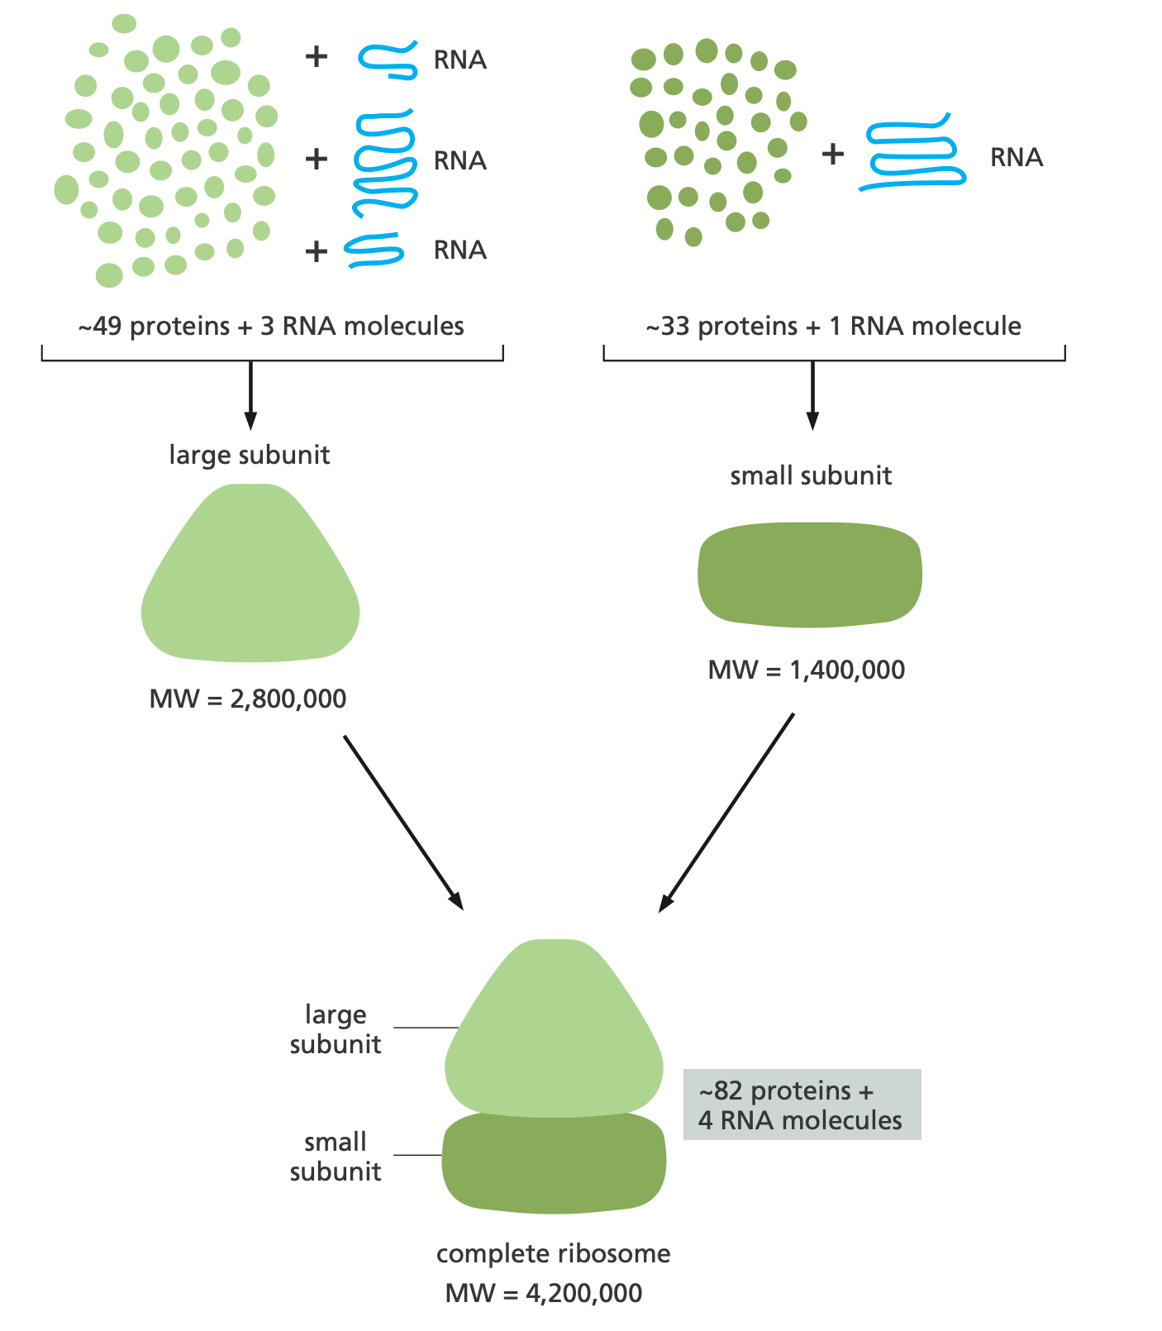
Ribosome Structure

Slide 14
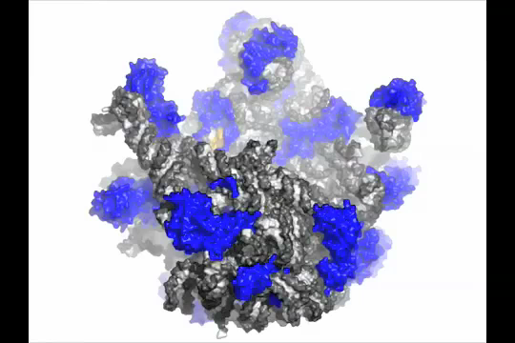
Atomic Perspective

Slide 15
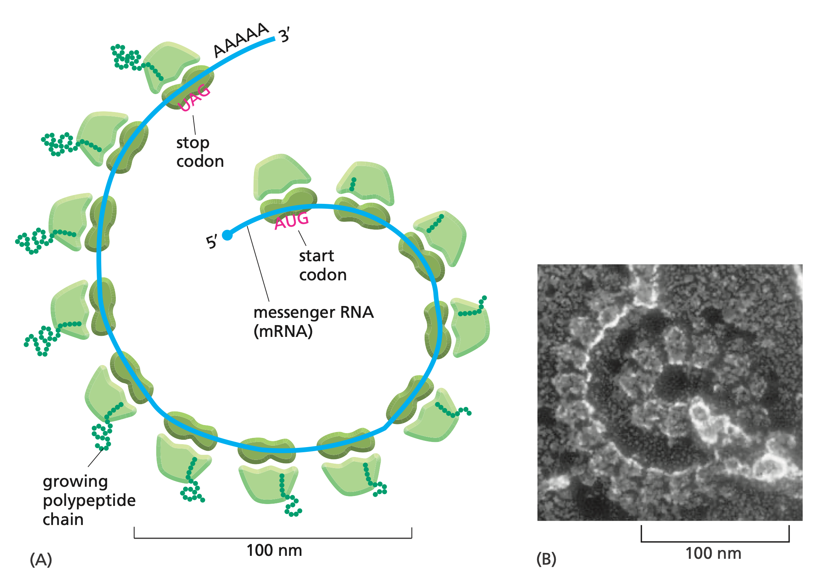
Polyribosomes

Slide 16
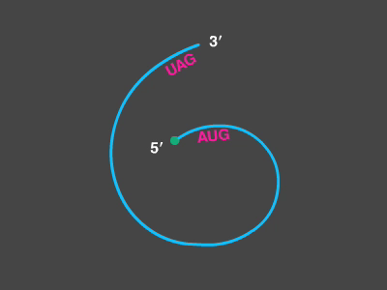
Polyribosomes

